Slide 1
Probabilistic Robotics
Francis Poole

Slide 2
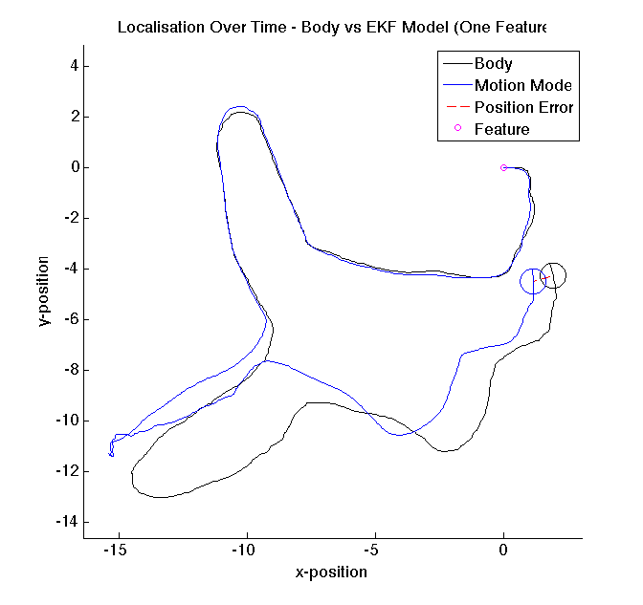
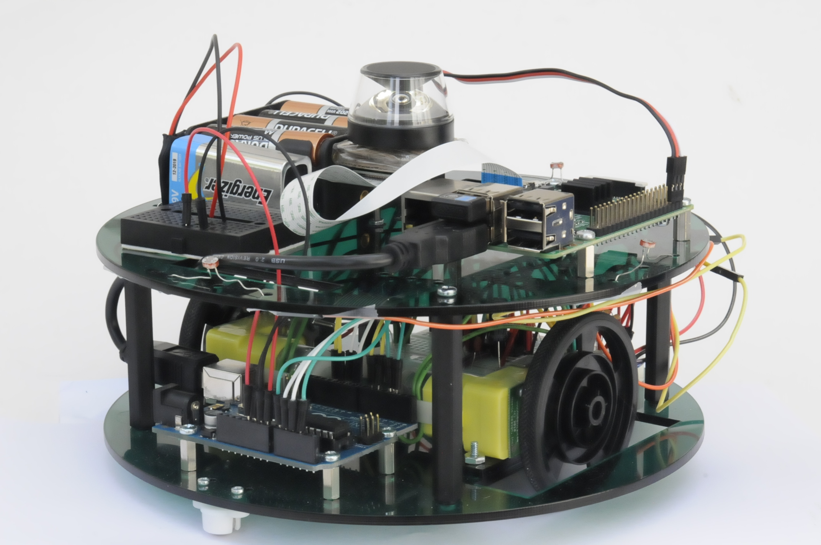
Overview of Project
Locate a robot’s position in the world by using an Extended Kalman Filter (EKF) to combine different predictions of the robots location
1. Simulation
2. Hardware
Notes:
This project attempted to combine multiple predictions that a robot makes about its position in the world, thereby producing a more accurate and certain prediction than each individual prediction. An Extended Kalman Filter, or EKF, who’s implementation I will discuss later on
This was first done through a simulation
And was then transferred to a purpose built robot

Slide 3
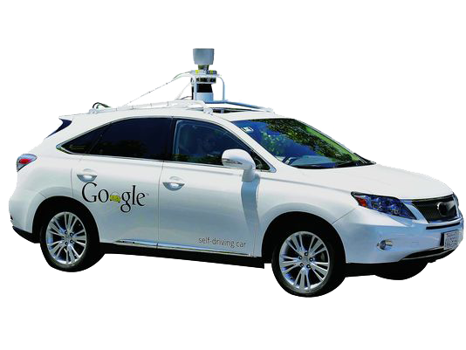
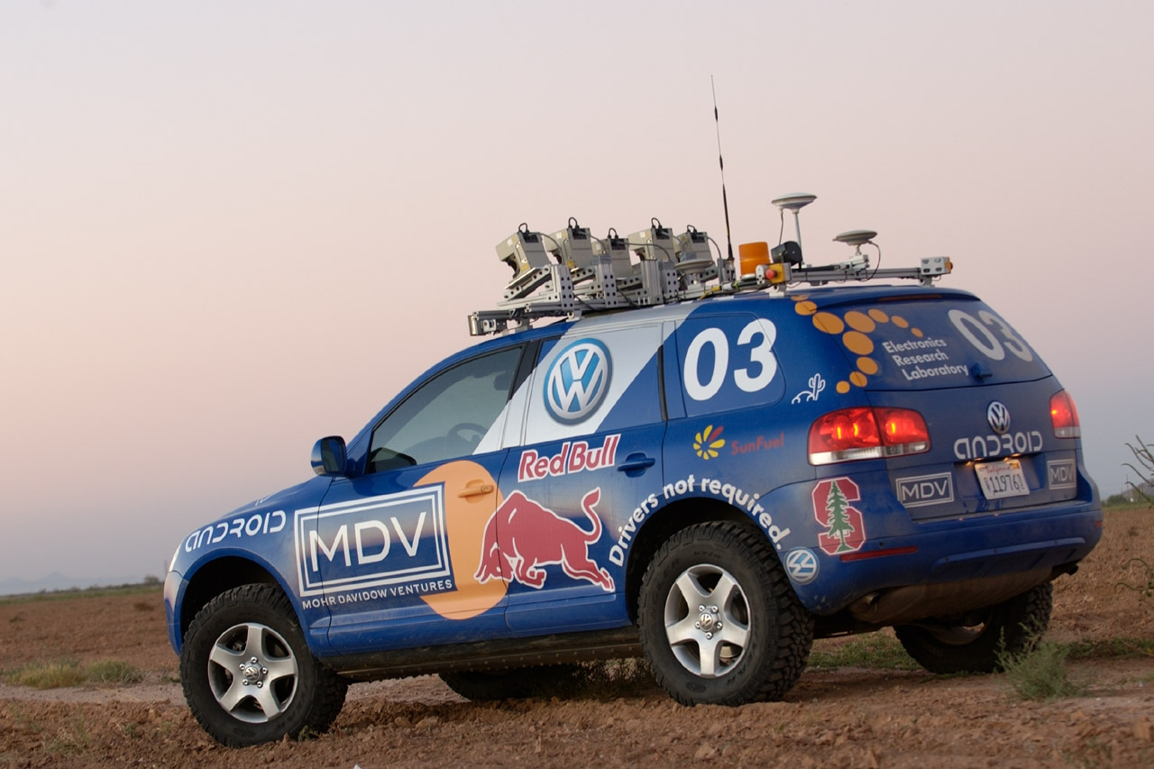
Importance of Localisation 1
Autonomous Cars
Google Car
http://static01.nyt.com/images/2012/10/28/automobiles/28JPSELF/28JPSELF-articleLarge.jpg
“STANLEY” – DARPA Grand Challenge 2005
http://newsdesk.si.edu/sites/default/files/photos/4366h.jpg
Notes:
But first, why is this” localisation” behavior important?
Currently a growing demand for cars that can drive themselves
Such as the famous Google car that uses localisation to be able to navigate the streets of San Francisco
And STANLEY, designed by Stanford, which won the DARAPA grand challenge in 2005, and was able to navigate across very rough terrain in the desert

Slide 4
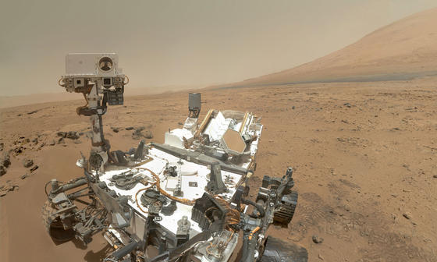
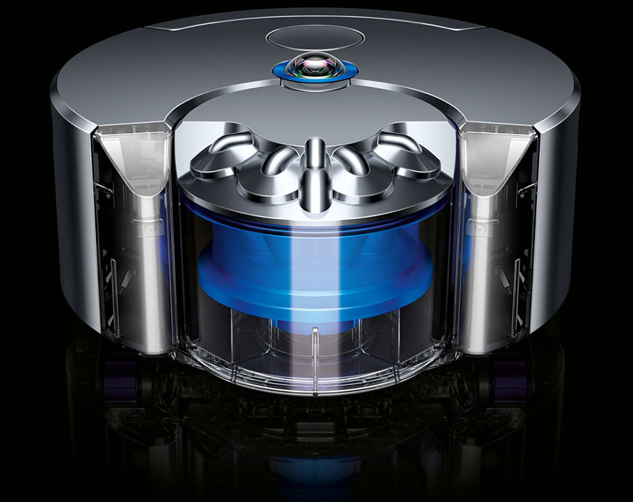
Importance of Localisation 2
Autonomous Rovers
Curiosity
http://mars.nasa.gov/msl/images/pia16239_c-hpfeat.jpg
In The Home
Vacuum Cleaners
https://www.dyson360eye.com/img/content/dyson_still_1-mobile.jpg
Notes:
The curiosity rover on Mars requires huge amounts of autonomy through localisation due to the large time delays between signals sent from earth being received
Even in the home, vacuum cleaners are being given some level of autonomy by navigating our floors
All of these areas require some kind of localisation behavior to take place

Slide 5
Simple Localisation
Odometry
Use motion sensors to keep track of the robot’s position over time
Sensory Measurements
Calculate position based on sensory readings of the robot’s surroundings
Compare to a given or generated map
E.g. Cameras, range finders, GPS etc…
Notes:
There are many methods of localisation however two common and simple methods that provide this localisation behaviour are:
First odometry, where by keeping track of movement over time, you can estimate the new position
The second is using sensors to measure the world around the robot and then comparing this to some map to get a location
Cameras, range finders and GPS are a few of the many possible sensors that can be used for this

Slide 6
What is the Challenge?
The real world is a noisy place!
Problems with Odometry:
Small errors from wheel slip accumulate over time
Model of motion in the world is never completely accurate
Problems with Sensory Readings of the world
Sensors heavily dependent on the outside world conditions
E.g. Dark rooms, surfaces, tunnels…
Maps of the world are never completely accurate
Notes:
So what is the challenge with locating these mobile robots in the world?
Well the world is a noisy place!
Odometry can accumulate a large error over time from any tiny ones that exist
These can come from things like wheels slipping or your motion model not being accurate enough
Sensory readings suffer from problems in the outside world
Dark rooms can make cameras useless
Types of surfaces and their angles can cause havoc to distance sensors
Tunnels can stop gps from getting a signal
Maps of the world are also never completely accurate

Slide 7
Probabilistic Robotics
Assume the world is noisy and your location is always a prediction with some belief
Combine predictions to produce better ones
Combine odometry with sensory measurement
Notes:
Probabilistic Robotics side steps these issues by understanding that the world is a noisy place and realising that your location is always a prediction that has some belief
Combining predictions can however produce more accurate and confident predictions
So odometry and the sensory measurement could therefore be combined!

Slide 8
Extended Kalman Filter (EKF)
A way of recursively combining Gaussian distributions optimally
Can treat predictions as Gaussians to allow them to be combined
Predictions must be linearised using Taylor expansion
Notes:
The extended Kalman filter is a way of recursively combining Gaussian distributions
So if we ensure our predictions are Gaussian the we can use this EKF to combine them optimally!
Linearization of our predictions is done using Taylor expansion however that is beyond the scope of this project

Slide 9
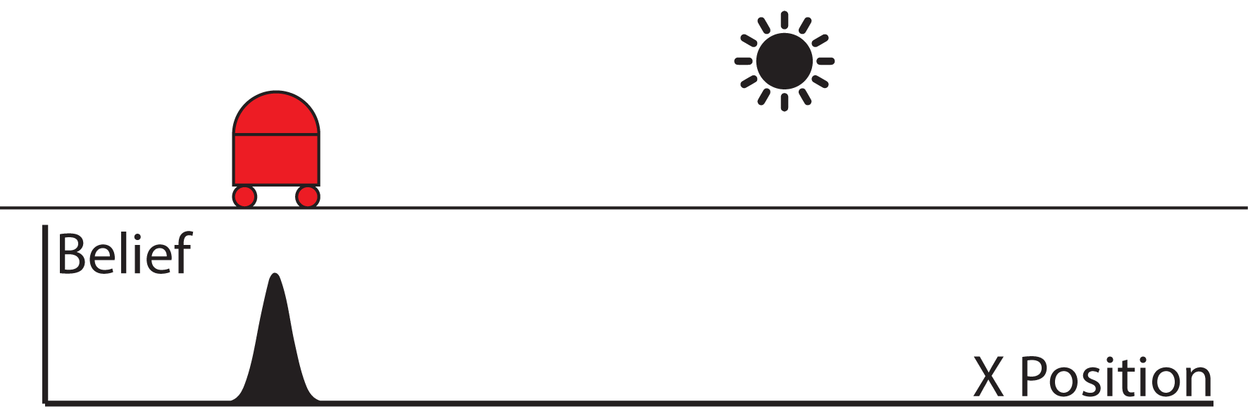
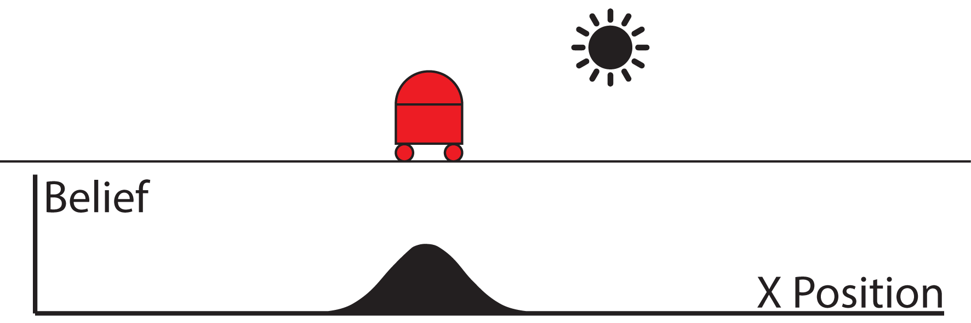
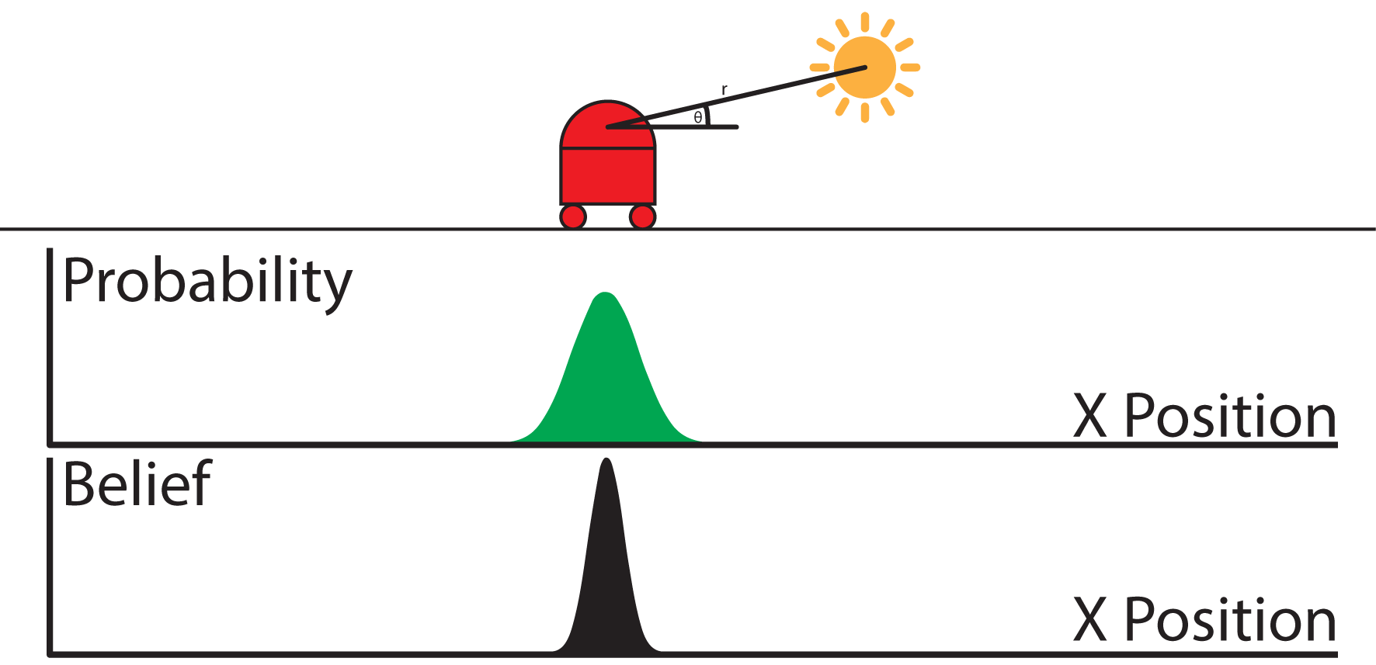
EKF for Mobile Robot Localisation
Step 1: Initial Pose Estimation
Step 2: Prediction Step
Step 3: Measurement Update
Notes:
When used for localisation of a mobile robot, the EKF has 3 steps:
1: The first is the initial pose estimation, where an initial belief of the robots position in the world is made
2: The prediction step then updates this belief using odometry to give a new belief, however noise in the world means the belief is less accurate and wider
3: The measurement update step then gives a probability distribution of the robots locations based on the sensory measurement and combines this with the belief from the prediction step. This produces a more accurate and slimmer belief of the robots position. In this case the sensory measurement has been made by measuring the range and bearing to a known light source in the world, a method that was used for the real world robot

Slide 10
Simulation
Simulation of agent first to be implemented in Matlab
Used an EKF algorithm outlined by Thrun et al. in Probabilistic Robotics (2006)
Wheel velocities used to predict motion of agent
Feature detection used for sensory measurement to measure range and bearing to known landmarks in the world
Imaginary sensor used
Notes:
First a simulation was implemented in Matlab using an EKF algorithm outlined by Thrun et al.
During the prediction step, wheel velocities were used to predict the motion of the agent
During the measurement update step, simple feature detection was used to measure the range and bearing to known features in the world, known as landmarks. An imaginary sensor allowed was assumed to give a reasonable result

Slide 11
Simulation DEMO
Notes:
Show body, motion model and EKF
Show error over time in distance

Slide 12
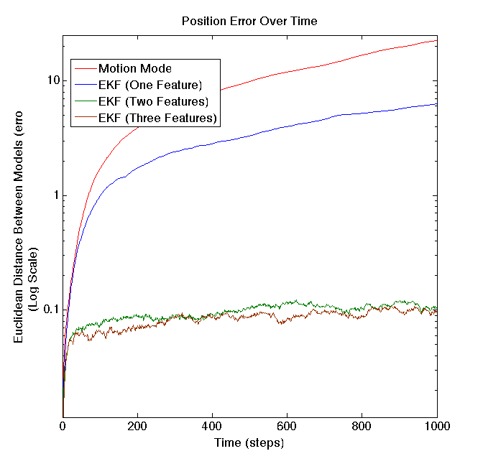
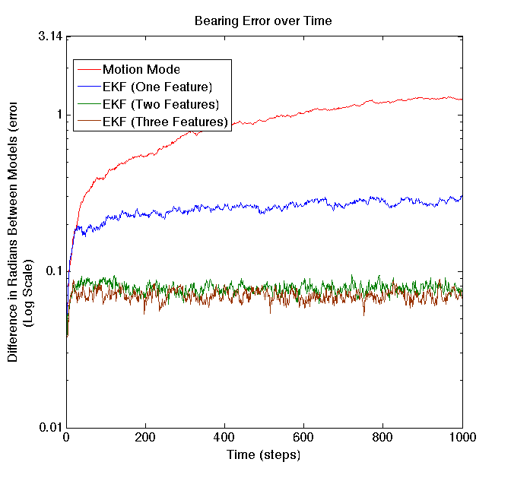
Simulation Results
Notes:
As can be seen from these graphs showing the position and bearing prediction error over time, the motion model by itself did very badly, however a single feature EKF was a lot better. More than one feature produced even better results!

Slide 13
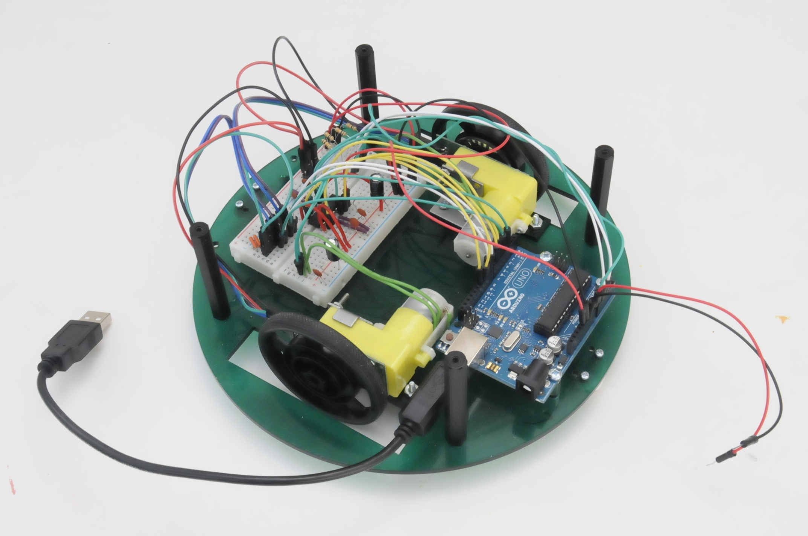
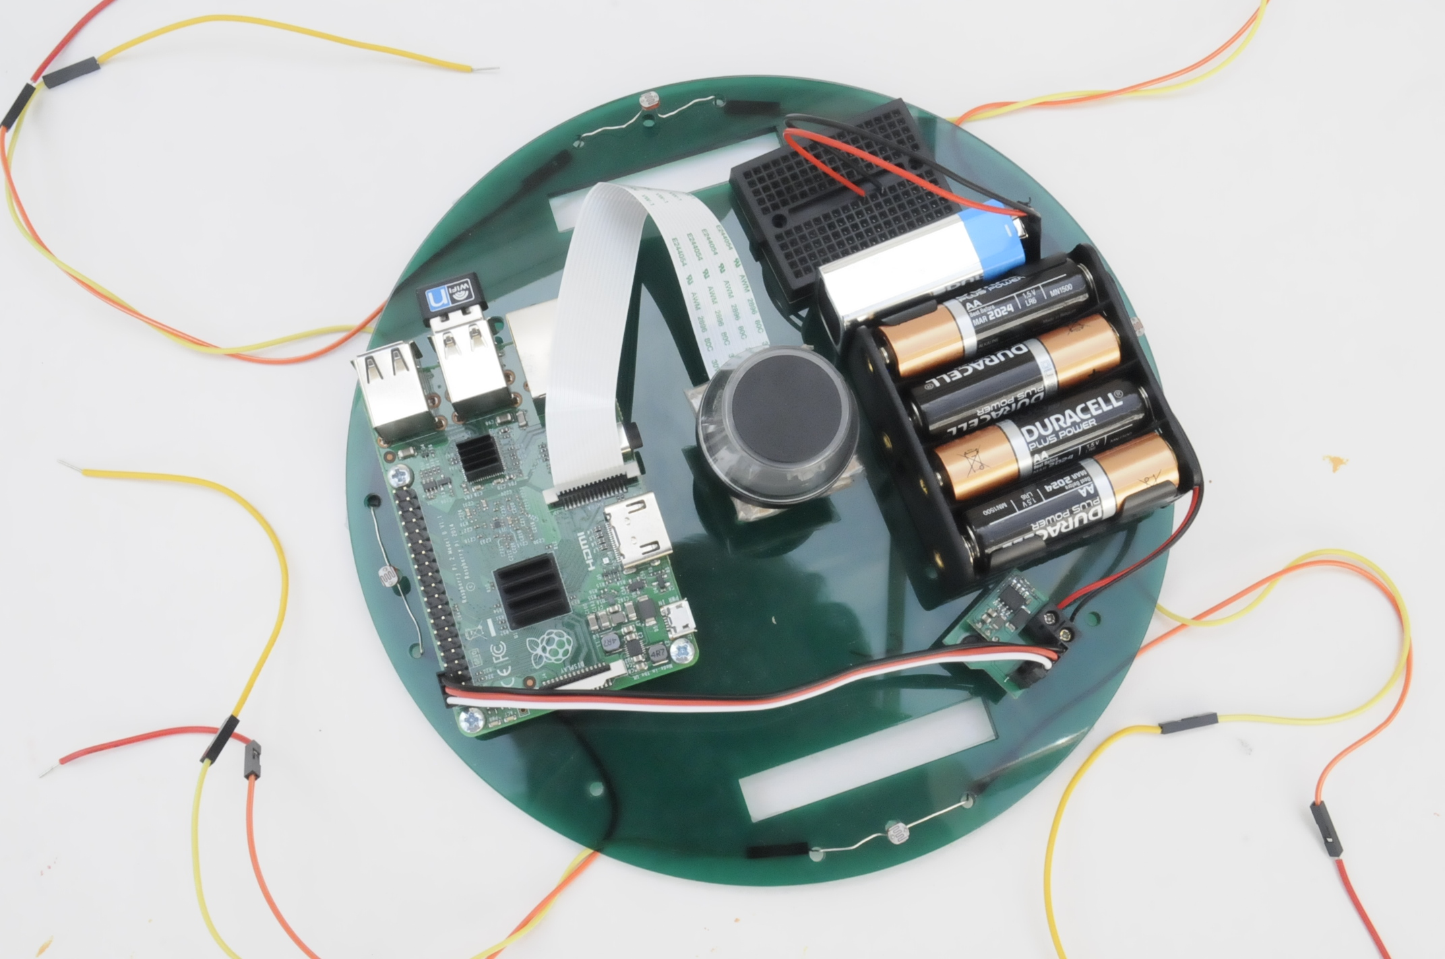
Transferring to Hardware
Arduino:
Controlled motors
Read encoders
Read light sensors
Raspberry Pi:
Run EKF
Connected through Serial USB
Notes:
Once the simulation was completed, the EKF was transferred to a hardware implementation
An Arduino was used to control two gear motors as well as read from encoders that recorded each wheels rotation for the prediction step and four light sensors that recorded the distance and bearing to a single nearby known light source for the measurement update.
A Raspberry Pi allowed for rapid running of the EKF algorithm to combine the predictions made using the encoders and light sensors

Slide 14
Hardware DEMO
Notes:
Show movement back and forward and gives motion model and EKF answers
Explain why light sensors not calibrated and is actually a problem with using a light source, need moderately controlled conditions

Slide 15
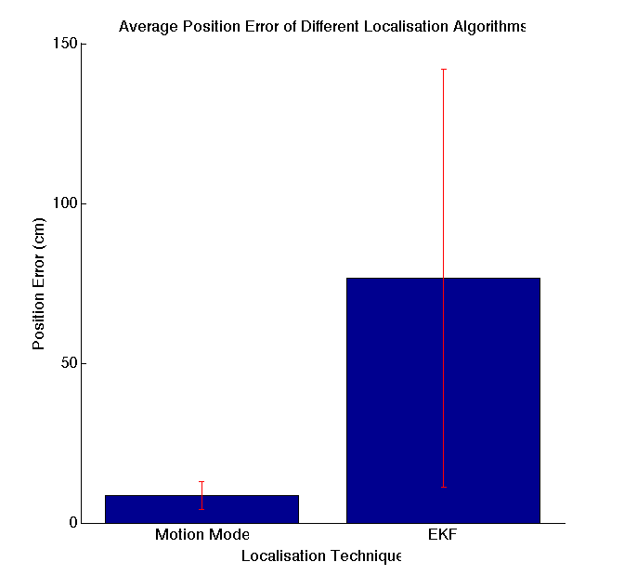
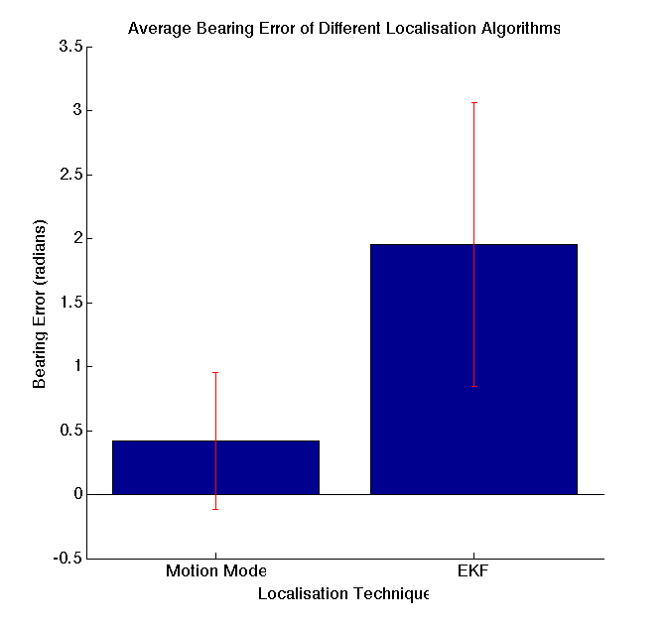
Hardware Results 1
Notes:
Discuss results

Slide 16
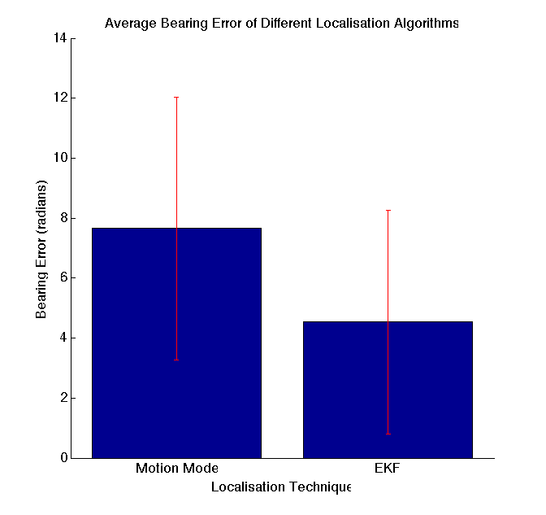
Hardware Results 2
Notes:
Explain Range to single landmark is better however
Single landmark means sensors prediction is in circle around landmark,

Slide 17
Conclusion
Project provided insight into cutting edge field of probabilistic robotics
Simulation produced accurate localisation behaviour using the EKF
Hardware produced surprisingly accurate motion model however failed to produce a better prediction using the EKF
Notes:
In conclusion this project provided me with valuable insight into an incredibly interesting and current topic
My simulation worked very well and showed the EKF providing a more accurate prediction of the agent as it moved around
Transfering to hardware however gave some interesting results, including the motion model performing better than the EKF and the EKF performing very badly

Slide 18
Possible Extensions
Using a 360-degree panoramic camera to allow for feature detection of multiple coloured landmarks in the world
Implement “return to base behaviour”
Test other probabilistic robotics techniques
Unscented Kalman Filter
Histogram Filter
Particle Filter
Notes:
There are many possible extensions to this project,
The first would be to use a 360 degree panoramic camera to allow for multiple features to be detected by detecting coloured objects in the world
Return to base behaviour could then be added allowing the robot to move back to its position of origin after wandering the world
Other probabilistic robotics techniques could also be used by looking at other ways to linearise the predictions through using the unscented kalman filter or by using sampling to produce more accurate but more complicated predictions

Slide 19
Questions?
Notes:
Thank you and any questions?

